Slide 1

Linear Algebra
Ahmed Abdelmoneim Mohamed
Head of Ai at ZigZag Club
https://www.linkedin.com/in/ahmed-abdelmoneim15/

Slide 2
AGENDA
01
02
03
04
Connection between linear algebra and data science
Vector
coding
Matrices

Slide 3
Connection between linear algebra and data science?
Linear algebra is at the core of data
science and is then largely used in the
most powerful Machine Learning
algorithms about recommendation
engines (Netflix, Amazon…),
Natural Language Processing (Alexa, Siri,...)
computer vision, etc.

Slide 4
— Vector :
“An array of numbers, either continuous or discrete, but most machine-learning /data science problems deal with fixed-length vectors”
Direction
20
10
15
22
magnitude

Slide 5
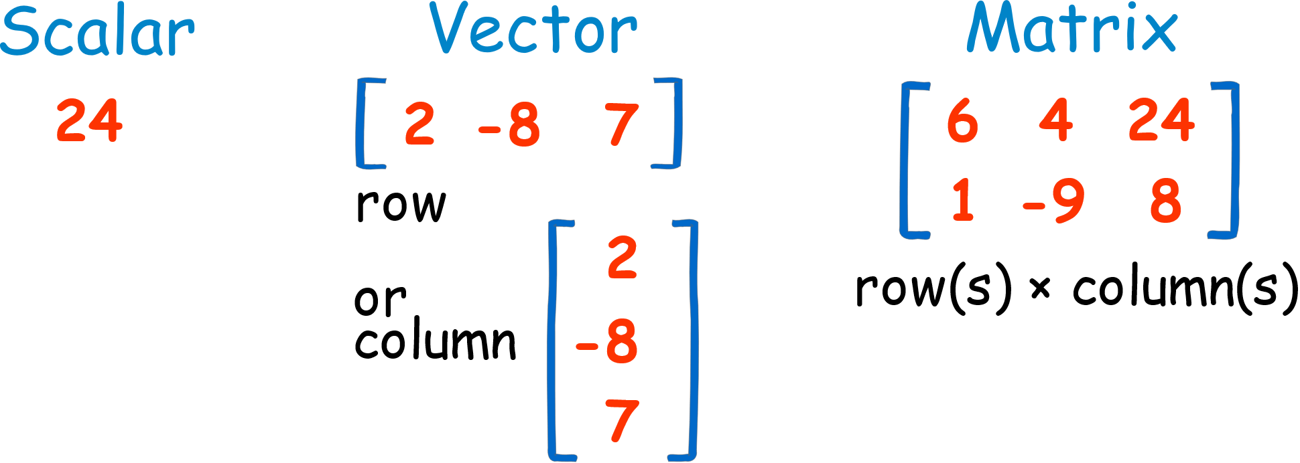
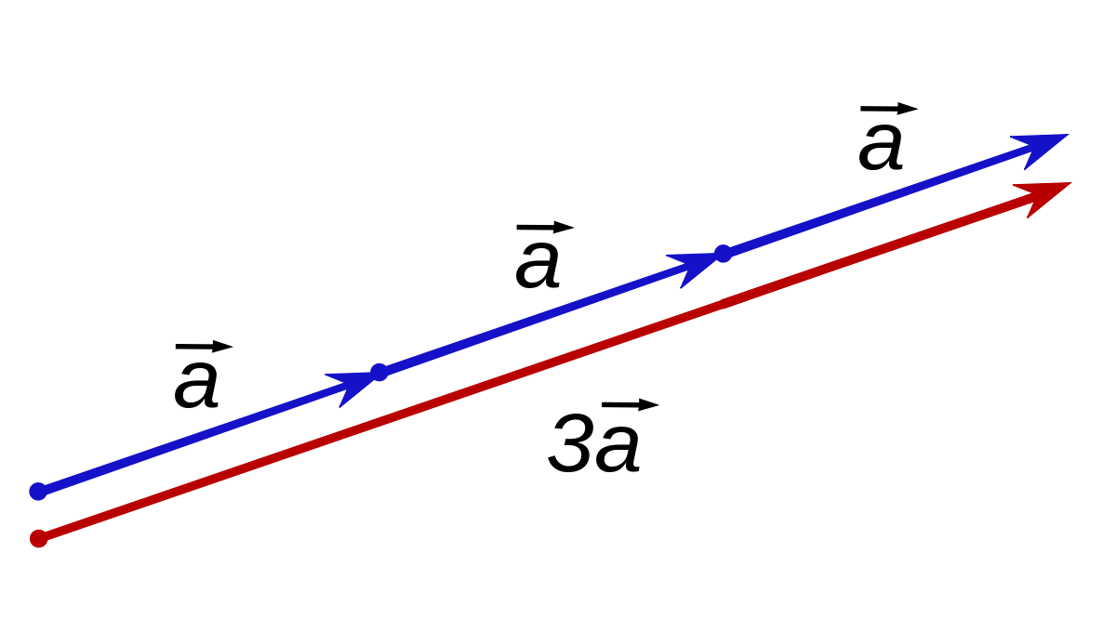
Scalar:
one-dimensional vector is a scalar.
is a quantity that has only
magnitude and no direction.
Unlike the vector that has direction
and magnitude.
Vector Scaling

Slide 6
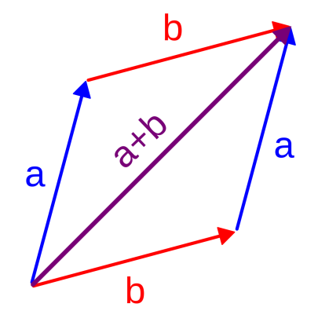
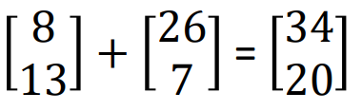
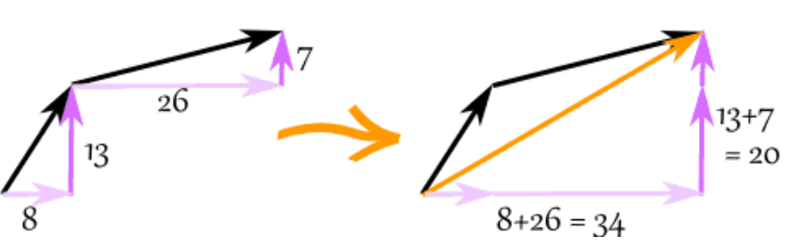
Vector Addition

Slide 7
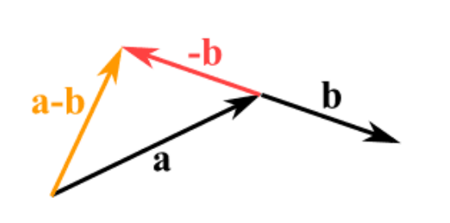
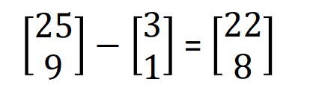
Vector Subtraction first we reverse the direction of the vector we want to subtract, then add them as usual

Slide 8
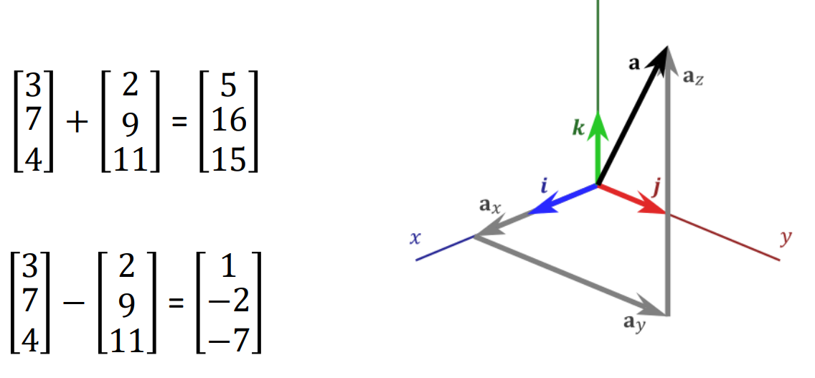
Vector Addition & Subtraction (3D)
Z

Slide 9
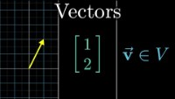

Slide 10
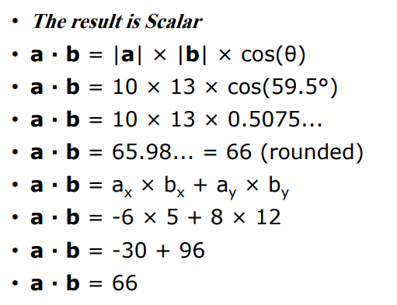
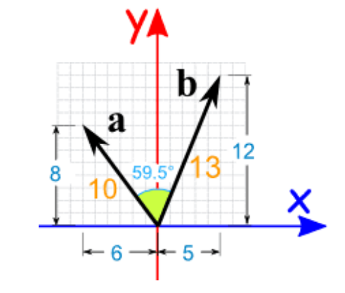
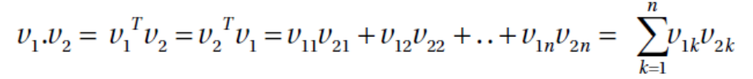
Vector Dot/Inner Product

Slide 11
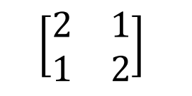
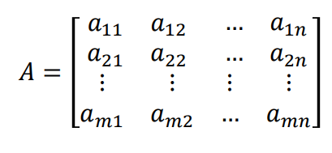
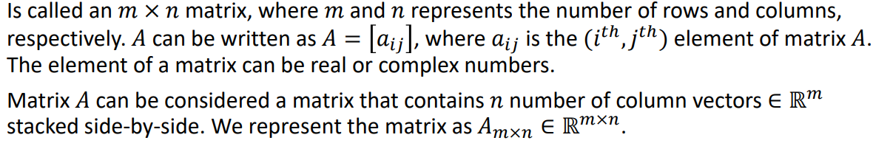
Matrices
A matrix is a multi-dimensional array that has a fixed number of rows and columns and contains a number at the intersection of each row and column. A matrix is usually delimited by square brackets.
A rectangular array of numbers of the form

Slide 12
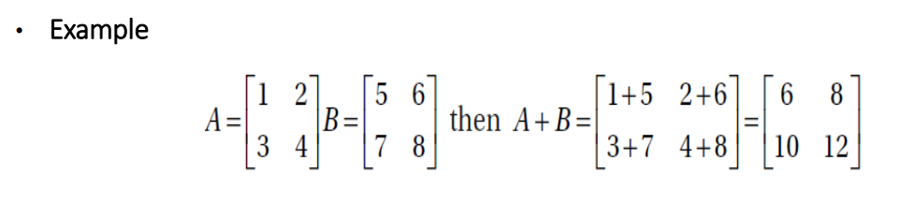
Addition of Two Matrices:
The addition of two matrices A and B implies their element-wise addition. We
can only add two matrices, provided their dimensions match.

Slide 13
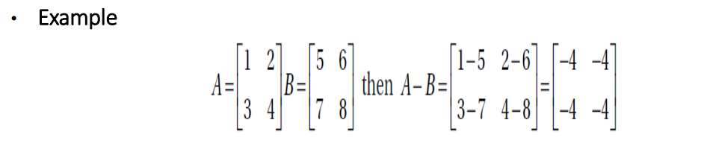
Subtraction of Two Matrices:
The subtraction of two matrices A and B implies their element-wise subtraction.
We can only subtract two matrices provided their dimensions match.

Slide 14
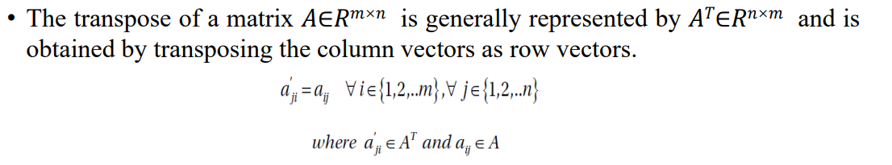
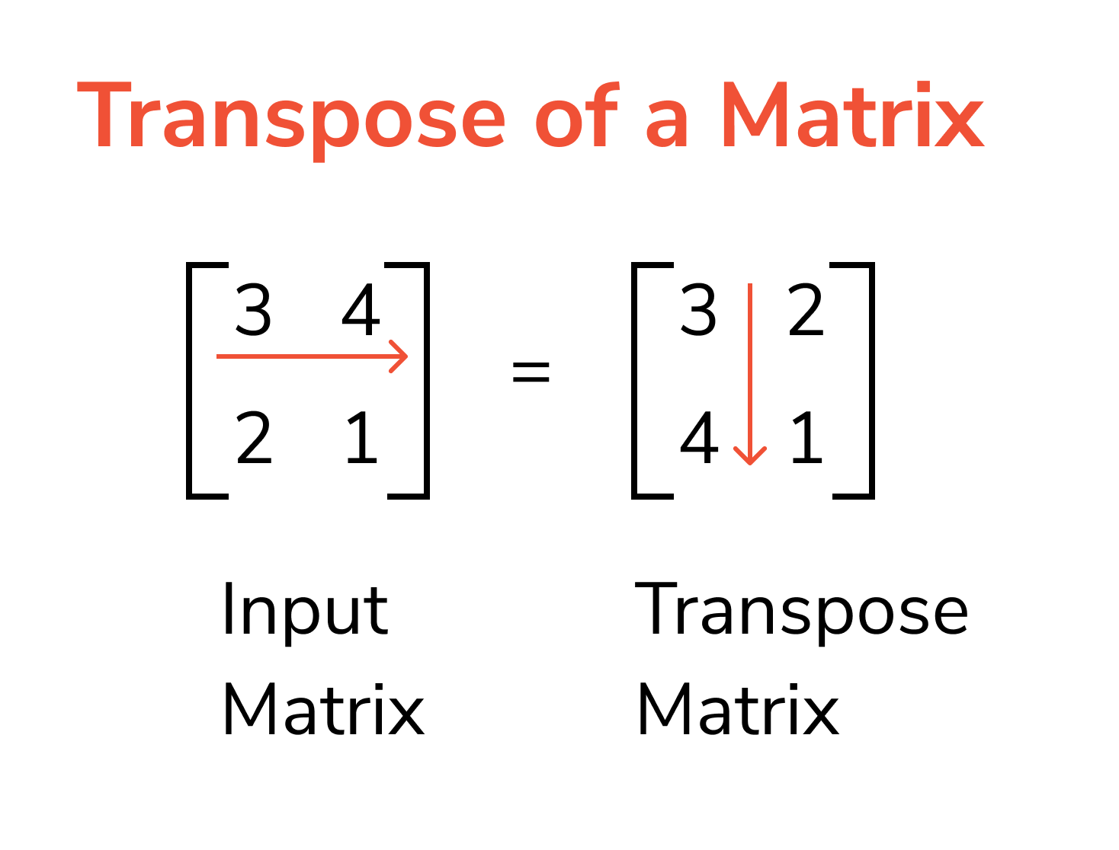
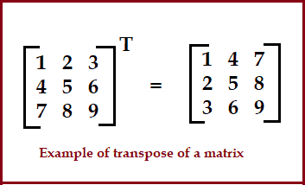
Transpose of a Matrix:

Slide 15
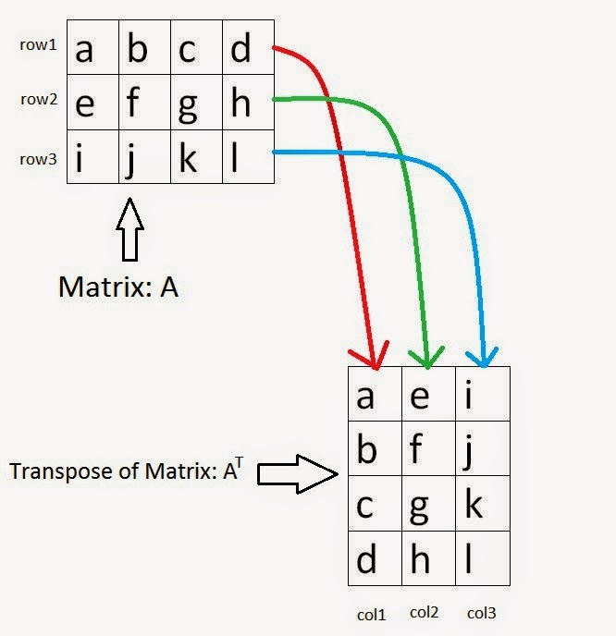
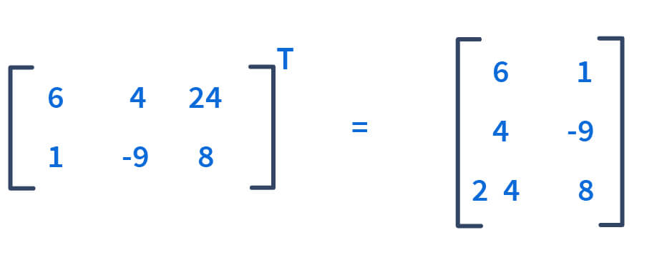

Slide 16
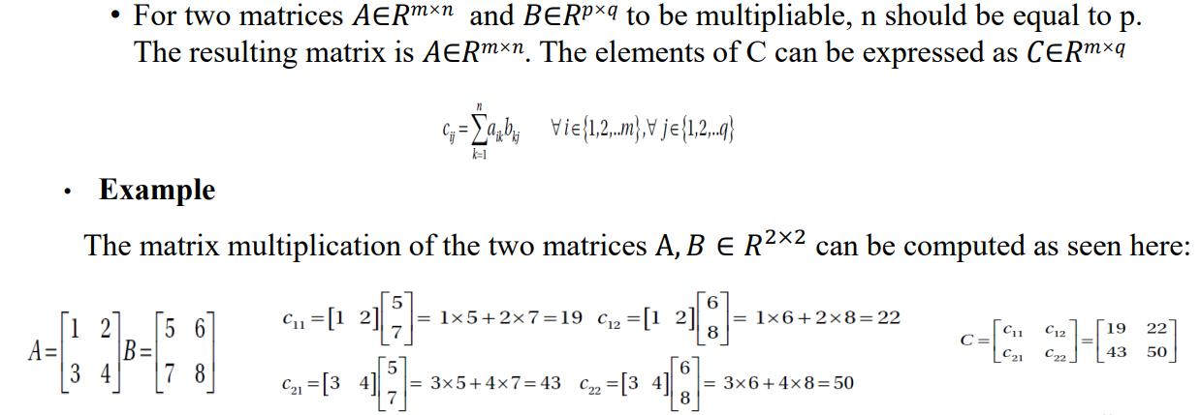
Product of Two Matrices

Slide 17
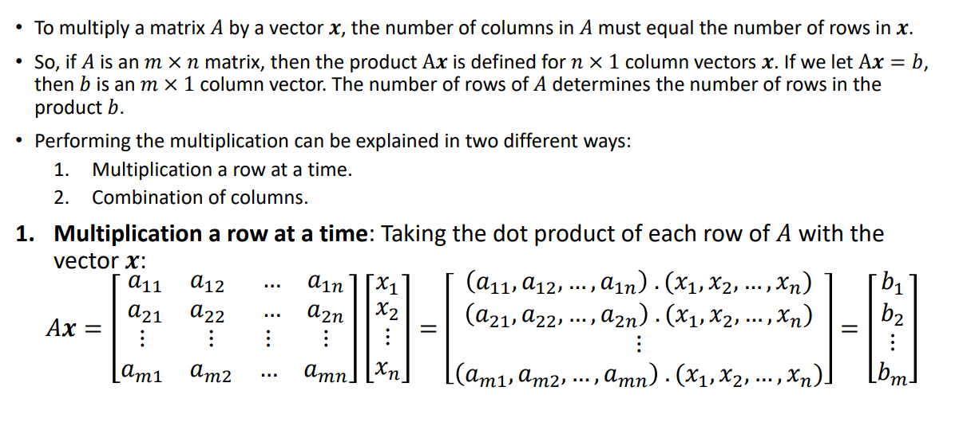
Matrix–Vector Product

Slide 18
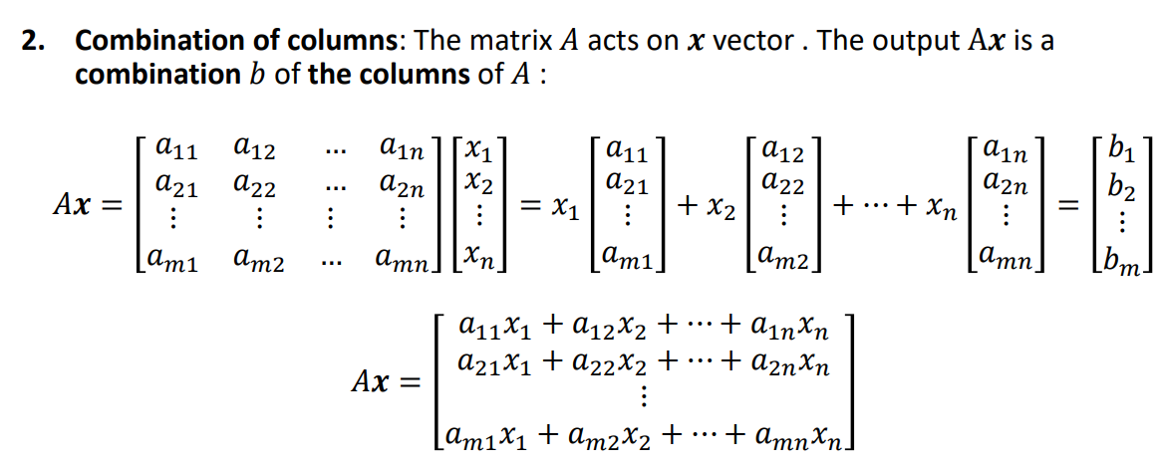


Slide 19
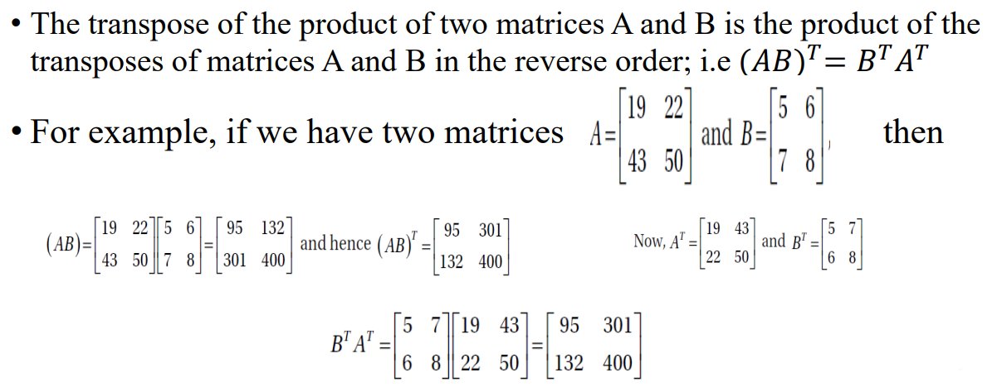
Example

Slide 20
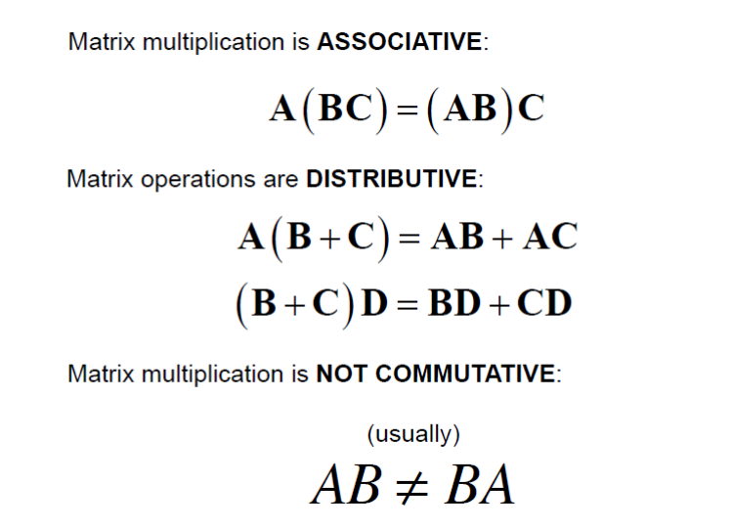


Basic Matrix Operation

Slide 21

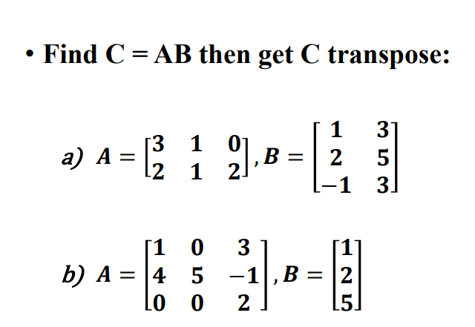
THE TASK
MA214: Linear Algebra khan Academy MIT 18.065 3Blue1Brown Linear Algebra for Machine Learning and Data Science

Slide 22
THANKS
Any questions?

